Slide 1

Project Plan process
Development process training
Mar. 2021
Rev 1.00
Sw division & qa division
Renesas design vietnam

Slide 2
Agenda
Introduction Page 03
Formulate Project Plan Page 06
Basic information Page 07
Management policies Page 12
Testing policies Page 13
Master schedule & Review plan Page 14
Tailoring Page 15
Selection item Page 16
Measurement & Analysis Page 17
Build project organization & Training plan Page 18

Slide 3
Introduction

Slide 4
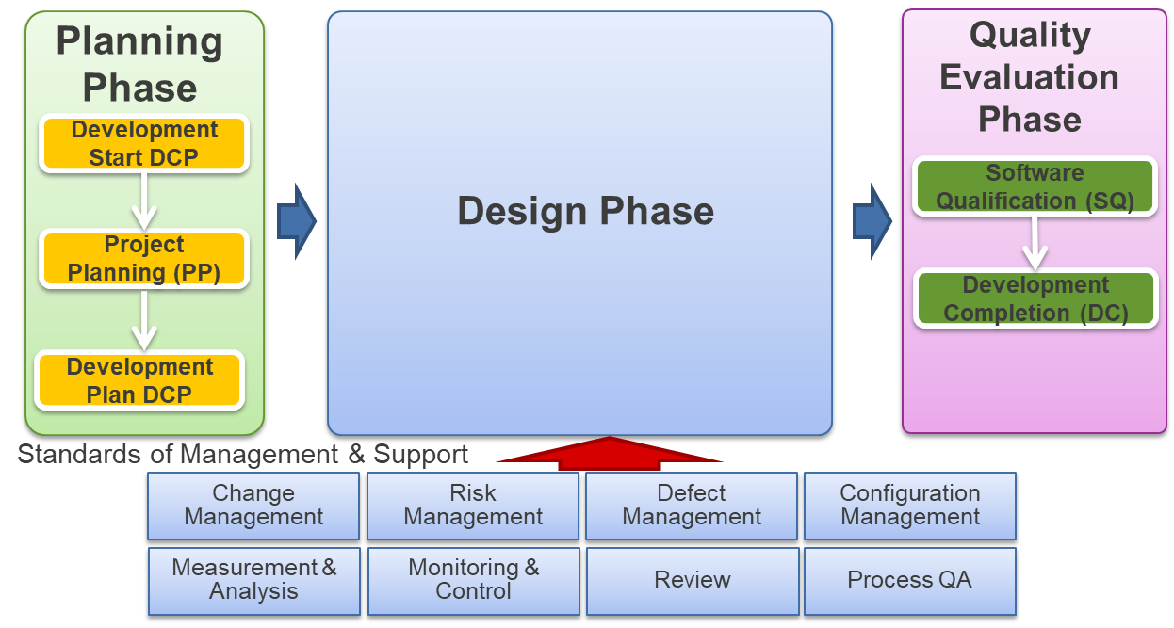
Introduction Project plan
In RCT-JB5001, Project plan process is a stage within Planning phase where development division will evaluate the feasibility of development project based on business viewpoint. Some of important items the development division must consider are investment cost, return on investment (ROI), available development resource, current technology, etc.
During Project plan process, project leader will formulate the project plan based on the result of Development start DCP and confirm the feasibility of quality, effort, schedule, resources, etc. And project leaders need to get the confirmation and agreement with all stakeholders for the formulated project plan before moving to Development Phase.
Note: Very important that Project plan need to be completed before project team can start any activity in Design Phase. Otherwise, that will be a big violation in JB5001

Slide 5
Introduction Project plan
During the Project Planning process, project leaders to complete following forms for completing Project Plan:
Project Plan template
Stakeholders table
Standard value & measured value regarding quality grade (short name: SVMVR table)
Open Source SW checklist (short name: OSS checklist)
IPR (Intellectual Property Rights) Quick chart
QA Data responsibility confirmation with REL (i.e. is it necessary to create QAData, who will create QAData table, etc.)
Standard Development Procedure Management Table (short name: SDPMT)
Measurement & Analysis Item table (if it will be used. Some projects might use tools like Redmine, Jira, Gerrit, etc.)
Risk Management Table (if it will be used. Some projects might use tools like Redmine, Jira, etc.)
Defect Management Table (if it will be used. Some projects might use tools Redmine, Jira, etc.)

Slide 6
Formulate Project Plan

Slide 7
Formulate Project Plan Basic Information
In Project Plan document, PL need to describe following basic information below:
Name of developed software, product type name
Development overview, requirement overview
Investment development budget
Master schedule
Development style in Design phase
Design Review implementation plan
Development target (quality and performance)
Software qualification, Quality grade, Development Level, legal regulation
Tools are used for development
Coding guideline
Release media
Whether reuse IP
Use of IPR Quick chart
Open Source Software checklist

Slide 8
Formulate Project Plan Basic Information
Name, Product type name, Development overview, Request overview
Project name / Project ID | (i.e. R-Car H264 Decoder)
Department responsible for design | (i.e. SoC Software Department / R-Car Middleware Group)
Name of product, Version (include target CPU/OS) | (i.e. R-Car Video Codec Ver 1.0)
Product type name | (i.e. RTM0AC0000XV264D30SL41C)
Customer [who provides development requests] | (i.e. BOSCH)
Requirement overview | (i.e. New function for H264 decoder: improve MPEG4 decoding standard compatibility. Performance: Improve 50% of decoding speed compare with previous product. Maintainability: All API can support 3 year compatible)
Development overview | (i.e. Develop SW product which perform H264 decoding. H264 decoding application will run on Linux OS platform.)
① Project name & Project information
② Product type name
③ Customer information
④ Request overview & Development overview
Can be completed after PP DR

Slide 9
Formulate Project Plan Basic Information
Investment amount and Payback plan
Investment development budget (estimated) |  | (i.e. 500000 USD)
Software Qualification, Quality grade, Software development level, Legal Regulations/Standards (e.g., ISO/TS)
Chargeable/Free of charge |  |  | (i.e. Chargeable)
Quality Assurance |  |  | (i.e. Necessary)
Quality Grade |  |  | (i.e. Q1)
Development level |  |  | (i.e. Level 2)
Person responsible for export control |  |  | (i.e. Project leader)
Export control |  |  | (i.e. EC-0990)
Classification result (CP) |  |  | (i.e. Not applicable)
legal regulations and standards to comply with (e.g., ISO/TS) |  |  | (i.e. This product will comply with ISO26262:2018 standard)
local rules to comply with (e.g., Coding rules) |  |  | (i.e. This product will comply with Renesas coding standard)
Contract matters related to product liability/guarantee |  |  | (i.e. This project using Outsourcing which comply with contact XXXXXXX)
① Investment and Payback plan
② Software Quality information
③ Legal Regulation information
Can be completed after PP DR

Slide 10
Formulate Project Plan Basic Information
Using below table to input Development environment information:
Development environment such as tool, evaluation board etc., and its scheduled date for acquisition
Development Environment
No. | Name of Development Environment | Version | Quantity | Person in charge | Acquisition date | Reference information for Tool Qualification
1 | (i.e. E2 emulator) | (i.e. v1.00) | (i.e. 2) | (i.e. Project leader) | (i.e. 2021/01/01) | (i.e. None)
2
3
4
5
6
7
8
9
10
11
12
13
14
15
Only required for Functional
Safety project
Can be completed after PP DR

Slide 11
Formulate Project Plan Basic Information
Besides that, there are also another information:
Development Cost & evidence
Development Cost & evidence |  | (i.e 4500 KLOC, 640 man-hours, 2000 test cases, etc. with detail estimation described in Sheet “Estimation”)
Criteria of deviations
Criteria of deviations |  | (i.e. The criteria of deviation are below. 1. In case the actual man-hour in that process measured at the end of each process is higher than planned effort by 30% or more. 2. In case the actual end of date of each process is delayed than planned date by 1 month or more.)
① Estimated development cost/effort
with evidence to show your estimation
Note: Evidences are very important for other parties to judge your estimation are correct.
② Defined criteria when the deviation from Project Plan occurs
Note: If the defined criteria condition are met, Project Plan has to be updated, re-reviewed, re-approved by Project manager, then informed to relevant stakeholders. Sometimes, re Planning DR must be conducted.
Can be completed after PP DR

Slide 12
Formulate Project Plan Management Policy
Project leader will need to describe the management policy like below:
Development style & reason
Configuration & Change management
Progress management
Risk & Defect management
Traceability management
Branch & Merge management
Development Strategy
Development Strategy | (i.e. We select Sprint style development for this project development because this technology is new and customer requirements are likely to change frequently base on their feedback. Also we select Sprint timebox is 2 weeks to acquire feedbacks from customer as early as possible. Configuration management will use Subversion as tool to control the version of documentation and source code. For every release, we will setup a new baseline and control it with tag feature of Subversion. We will use Burn-down chart to monitor the progress with indicator is Story point values sum up from each task. Because our project are required to use tool rather than Excel to Traceability management so we will use Reqtify to conduct it Branch & Merge management can be refer to sheet “Branch_Merge_management”)
Product development history/Related Plan | (i.e. New product development)

Slide 13
Formulate Project Plan Testing policy
Project leader will define Testing policy/strategy and test constraint for below items:
Unit test
Integration test
Validation test
Regression test
Test Strategy
Test strategy (Unit Test, Integration Test, Validation Test) | (i.e. Unit test: Code coverage: 100% C0/C1 coverage Black-box test: check all input/output and status code for each functions Integration test: Conformance test: test base on H264 decoder conformance test suite Robustness test: test to ensure the robustness of decoder so that no abnormal behavior happen even with abnormal data Validation test: Performance test: check performance when integrate with overall system to ensure achieve 60 FPS) Regression test: When source code/object code was updated for any reason Regression test for current Test process and previous Test processes will be conducted.
Can be completed after PP DR

Slide 14
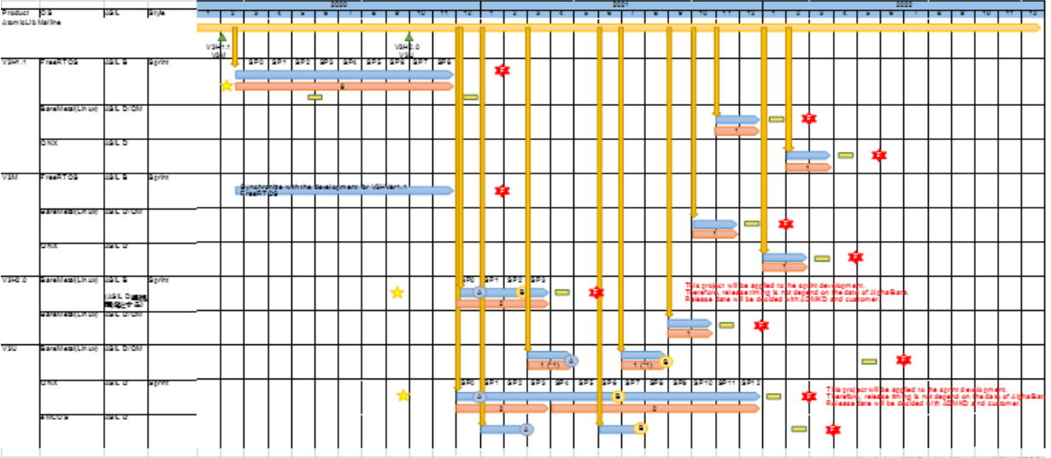
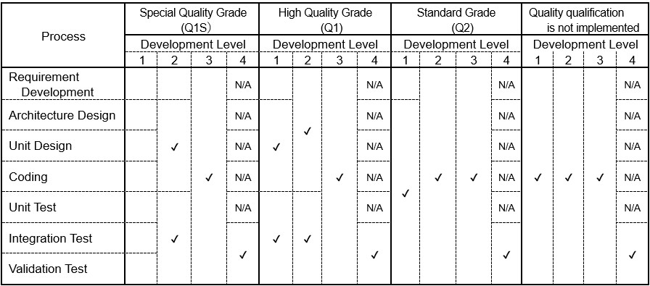
Formulate Project Plan Master Schedule & Review Plan
Project leader will describe the schedule or evidence for following item:
Master schedule
Peer review plan/schedule (needed for Waterfall Style development)
Design review plan/schedule
Development schedule & evidence
Development schedule & evidence | (i.e. For Master schedule please refer sheet “Master_Schedule”. Design Review plan is defined as below: PP DR: 2021/03/01 RD DR: 2021/04/15 AD/UD/CD DR: 2021/05/30 UT/IT/VT DR: 2021/08/30)
Note: For merging DR of multiple Processes into one DR meeting, PL need to follow “Appendix 3 Tailoring criteria for DR in Waterfall Style Development” policy
Can be completed after PP DR

Slide 15
Formulate Project Plan Tailoring
Design activities to be performed
No. | Process
1 | Requirement Development | Performed
2 | Architecture Design | N/A
3 | Unit Design | N/A
4 | Coding | Performed
5 | Unit Test | N/A
6 | Integration Test | N/A
7 | Validation Test | Performed
Tailoring of Measurement and Analysis
No. | Standard process description (The operation description before tailoring.) | Tailoring description (The operation description after tailoring.) |  | Reason for tailoring
1 | (i.e. In addition, measurement and analysis of Efforts(man-hours), review time(hours) and number of defects are performed to confirm the discrepancy between the actual performance and the project plan, and to make estimates and basic data for process improvement issues in future projects.) | (i.e. In addition, measurement and analysis of Efforts(man-hours) and number of defects are performed to confirm the discrepancy between the actual performance and the project plan, and to make estimates and basic data for process improvement issues in future projects.) |  | (i.e. We decide to tailor out review time due to project decide to use Online review for all review time so it is unnecessary to measure and analysis this indicator)
2
3
4
① Select which Design phase process activities will be performed
Note: For merging DR of multiple Processes into one DR meeting, PL need to follow “Appendix 3 Tailoring criteria for DR in Waterfall Style Development” policy
② Tailoring the measurement & analysis items depend on project situation

Slide 16
Formulate Project Plan Selection item
Prior consideration for Selection Item
No. | Selection Item | Selection | Condition | Timing
1 | (i.e. selection for method of sound verification) | (i.e. Pulse Generator/ Model Sim) | (i.e. Initial cost within 3 man-days.) | (i.e. CD process)
2
3
4
5
Describe the items to be considered in advance for the options that have a large impact on the project goal

Slide 17
Formulate Project Plan Measurement & Analysis
Measurement and Analysis item
No. | Objective | Measurement Item | Analysis Item | Timing
1 | (i.e. Confirming sufficiency of peer review for man-hours of process.) | (i.e. Review time(man-hours), Efforts(man-hours) of process.) | (i.e. Review engagement rate = Review time / Effort of process) | (i.e. Before DR)
2
3
4
5
Describe the items and timing of measurement and analysis for each items

Slide 18
Formulate Project Plan Build Project Organization & Training Plan
Project member & Training plan
No. | Name | Department | Role | Training Plan |  |  |  |  | Notes
 |  |  |  | Training Contents | Scheduled completion date |  |  | Actual completion date
1 | Nguyen Van A | SoC SW | Project leader | - | - |  |  | -
2 | Tran Van B | SoC SW | Project member – Person in charge of design and coding | ARM Optimization skill | 2021/01/31 |  |  | 2021/01/31
3 | Le Thi C | SoC SW | Project member – Person in charge of testing | R-Car Linux test environment construction skill | 2021/01/31 |  |  | 2021/01/31
4
5
6
7
8
9
10
Stakeholders other than project members
No. | Name | Company/Department | Role | Notes
1 | Pham Van D | SoC SW | Project manager
2 | Bui Van E | QA | Quality Assurance department representative
3
4
5
6
7
8
9
10

Slide 19
Formulate Project Plan Build Project Organization & Training Plan
Mailing List and Escalation Route
No. | Title | Mailing List / Route | Notes
1 | Project mailing list | prj-h264-codec@renesas.com
2 | QA department mailing list | prj-qat-rvc@rvc.renesas.com
3
4
5
Plan for meetings with stakeholders
(i.e. Title: Meeting with project member to monitor progress status Frequency: every week Participants: Project leader with all project members Record: a project member will record a meeting minutes and distribute it to Project leader and all project members)

Slide 20
Q&A

Slide 21
Renesas.com

Slide 22
Revision | Description | Creator | Check
1.0 | First version | Nguyen Nguyen | Quynh Tran

